Slide 1
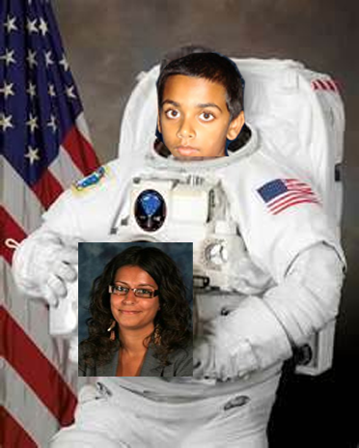
7SKR
L
eavers Powerpoint
Part 1
A good end to the perfect class

Slide 2
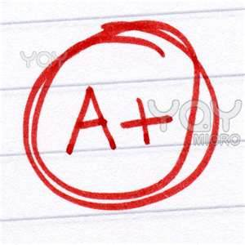
Kiran
Studied math at Harvard
And got an A+

Slide 3
Peter
Studied programming at Imperial College
and got an A+

Slide 4
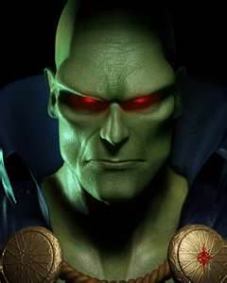
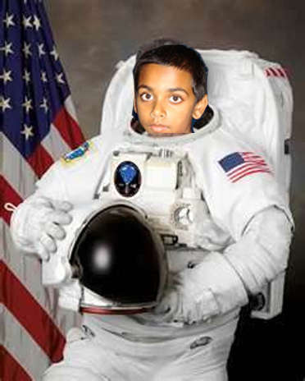
Jay
And,
went to the moon in 1969!
Studied time travel on Mars
somehow,
OMG, its Jay!!!

Slide 5
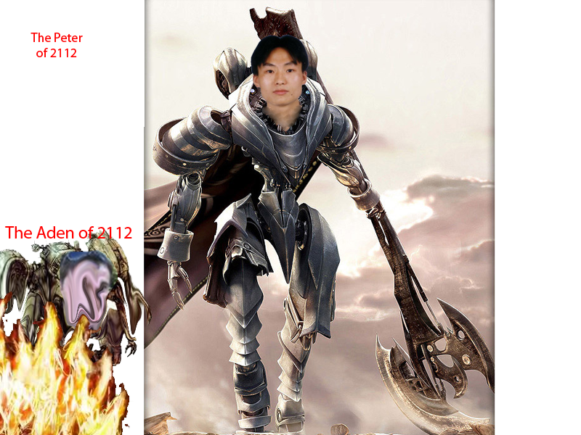
Aden
Got enslaved by the mechs
With his family…
Mech

Slide 6
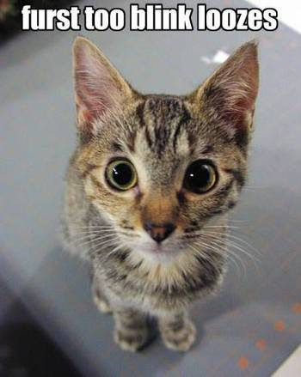
Malachi
Studied genetics and mutation in Yale and somehow ended up…

Slide 7
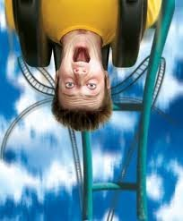
Shiv
Studied physics at Leeds
And got an A+

Slide 8
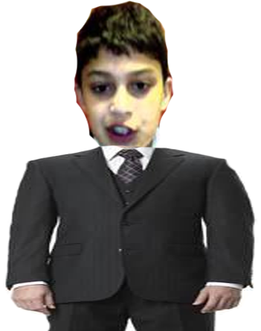
Layth
Studied economics at LSE
and got an A+

Slide 9
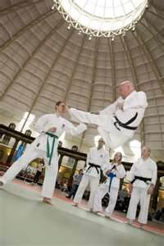
Vitthagen
Studied fighting in Japan
got a job,
And,
somehow,
As a body guard!
Where are you going?

Slide 10
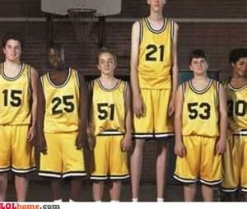
Luke
Studied basket ball in America
And got an A+
OMG!! Luke got tall!!

Slide 11
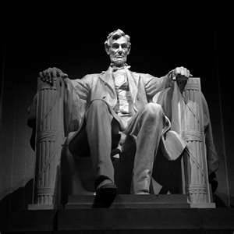
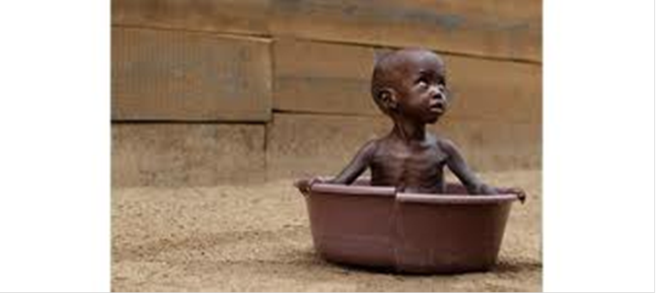
Tami
But decided he needed to experience it first hand.
Studied geography at Lincoln
And got an A+

Slide 12
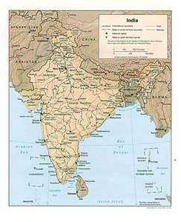
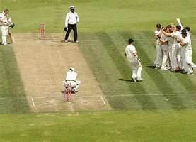
Dhruv
Studied Cricket in India
got bowled first ball!!
And,
somehow,
FAIL!!!

